Slide 1
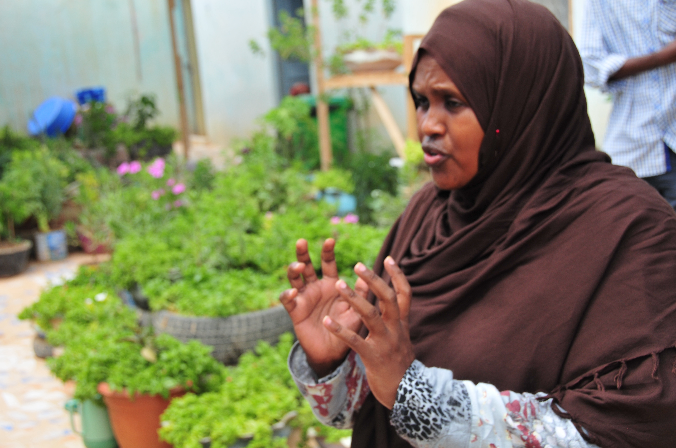
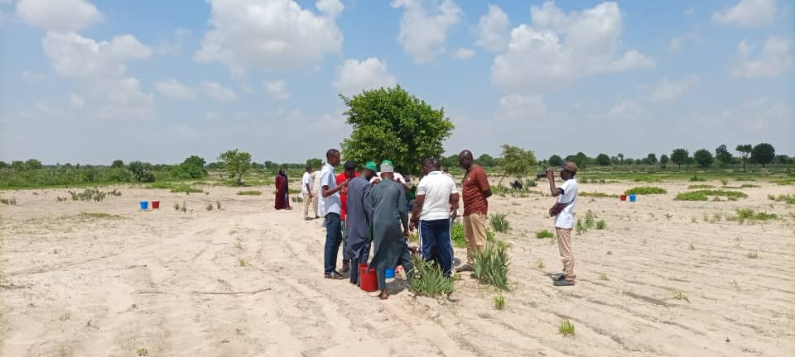
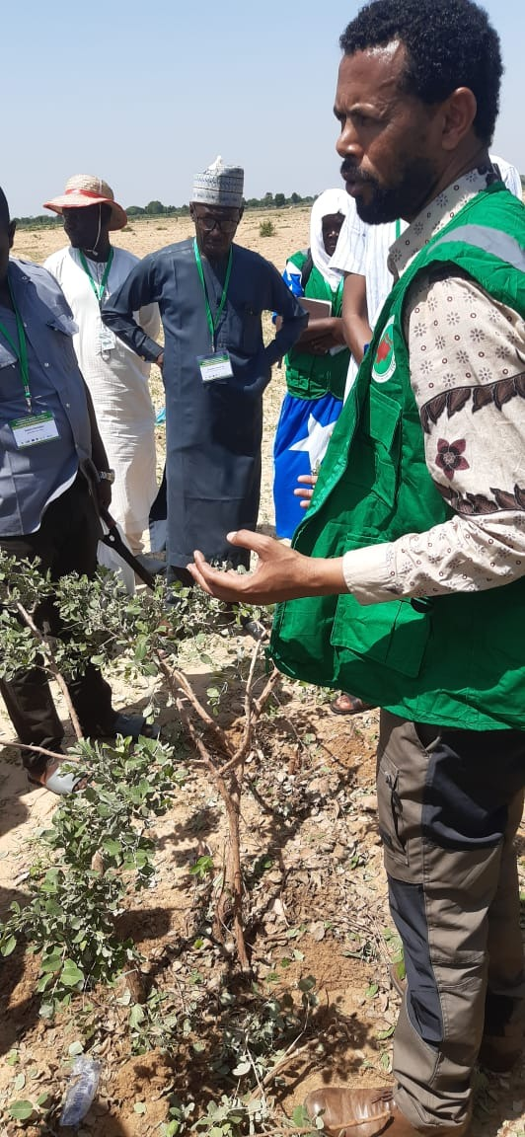

Implementing FMNR/PMNR For Afforestation
Training of Trainers
8th August, 2024
Knowledge For The Great Green Wall Action (K4GGWA)

Slide 2
Implementing FMNR/PMNR For Afforestation
Training of Trainers
Key Learning Opportunity - Gain and share practical experience on:
Implementation & management and scaling of FMNR/PMNR for Afforrestation
Context
Charcoal is the main fuel for most Somali households. The once majestic acacias and other trees that graced the rangelands have almost disappeared due to charcoal production and overall land degradation.
Sammy Carsan: Date: 8/08/2024
s.carsan@cifor-icraf.org

Slide 3
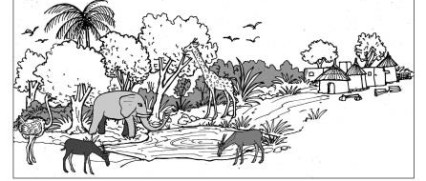
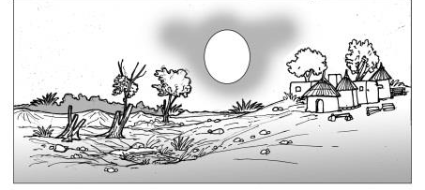
How has your environment changed in the last 10 years?

Slide 4
Production systems in the Somali context
46–56% of the land area is permanent pasture, while 20% is classified as forest and 13% is suitable for cultivation. The remaining land is not economically exploitable (UN Habitat 2006).
Community elders and clan leaders have the authority to allocate land to individual households and households enjoy rights over land they have historically owned.
FMNR practice can best fit in: (i) croplands and (ii) common grazing lands
Trees that can be established in croplands | Common lands
Sunut/Garad (Acacia nilotica) Yagcar (Boswellia frereana) Yagcar Faidherbia albida Galool: Acacia bussei | Badan (Borana): Balanites aegyptiaca Hashab: Acacia seyal/ senegal Qurac/Sisaban: Acacia tortilis Balsam: Commiphora myrrha
Notes:
charcoal is the main fuel in most Somali households. These uses create a strong demand. The once majestic acacias and other trees that graced the rangelands have almost disappeared due to the ravages ofcharcoal production.
Wild tree, fruits,
food and medicine (eg Zizyphus mauritiana, Boscia coriacea, Cardia sinensis, Balanites spp, Dobera grabra

Slide 5
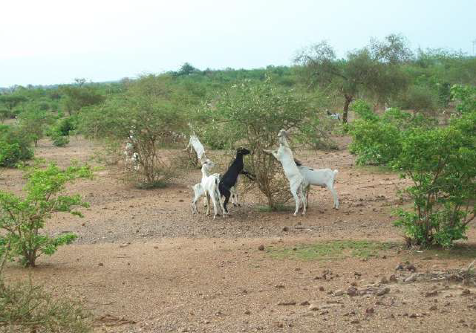
WHAT IS FMNR/ PMNR?
FMNR is the deliberate selection, protection and management of trees and shrubs from felled tree stumps and sprouting root systems in crop or grazing fields.
Direct seeding or enrichment planting can also be used to enhance biodiversity
Since it involves naturally growing trees, it is based on indigenous trees, often there is one dominant type found in the system e.g.. Faidherbia albida in Burkina Faso and Ethiopia
Notes:
Increases access to harvested products (shea and Nere fruits, firewood, e.t.c.);
Creates natural habitats for birds and animals thus promoting biodiversity restoration;
Promotes tree diversity and as a result improves honey production through the return of bees;
Increases food and nutrition security
Improves quality of life: less wind and dust, more shade;
Development of meeting places or public spaces
Reduces rural and land tenure conflicts

Slide 6
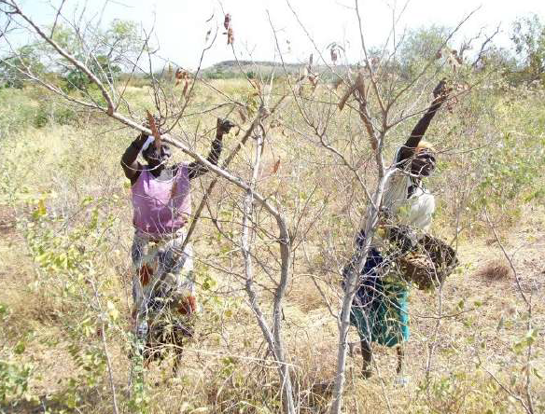
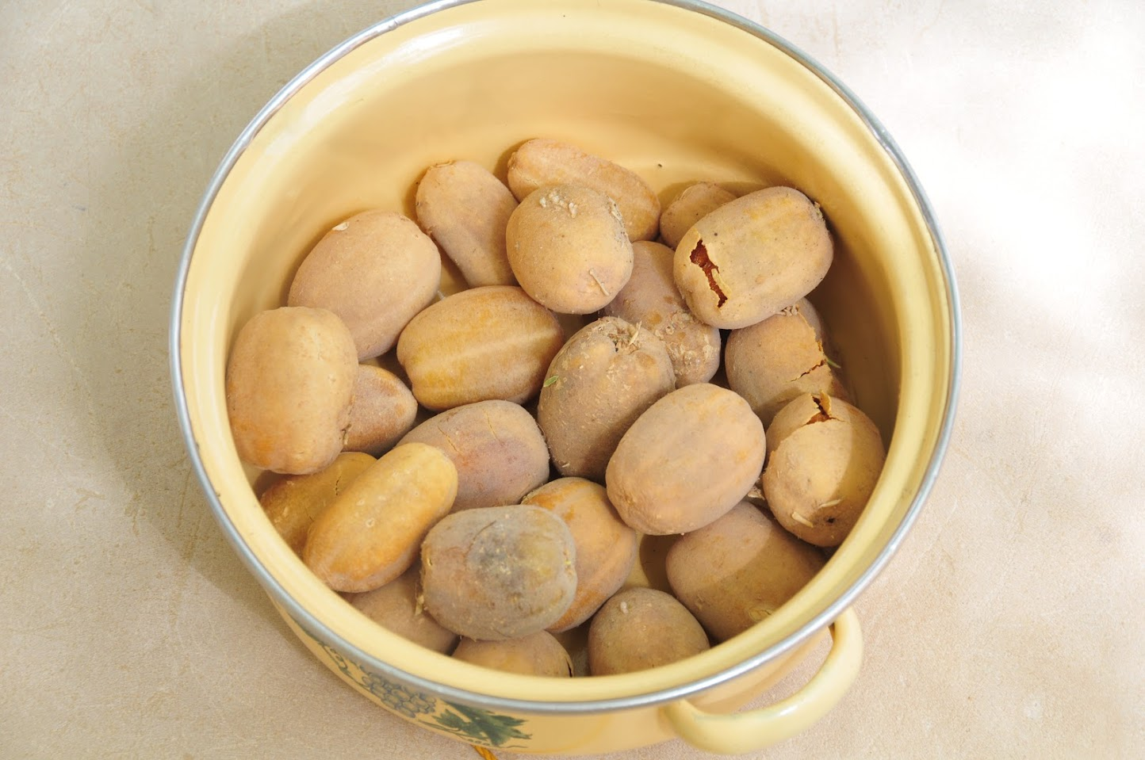
WHY PRACTICE FMNR?
Can help increases tree cover therefore access to harvested products (firewood, medicinals, herbs, fruits)
Conserves biological diversity;
Improves soil fertility;
Reduces soil erosion;
Mitigates the effects of climate change by promoting carbon storage and reduces the
portion of heat reflected from the soil;
Combats desertification;
Diversifies agro-sylvo-pastoral production.
Increases availability of fodder for animals;
Improves quality of life: less wind and dust, more shade;
Reduces rural and land tenure conflicts
Notes:
On the other hand, FMNR can be a quick, simple and secure method, through protecting and nurturing naturally occurring seedlings, or shoots from living stumps

Slide 7
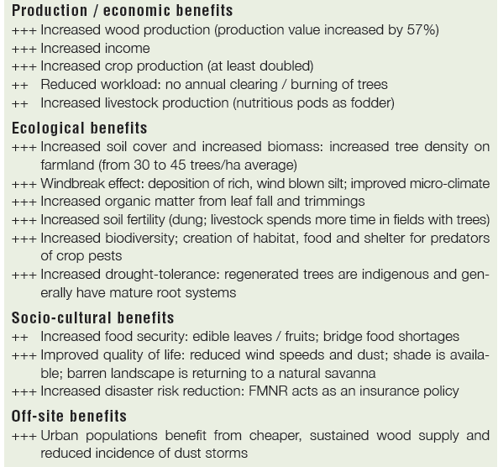
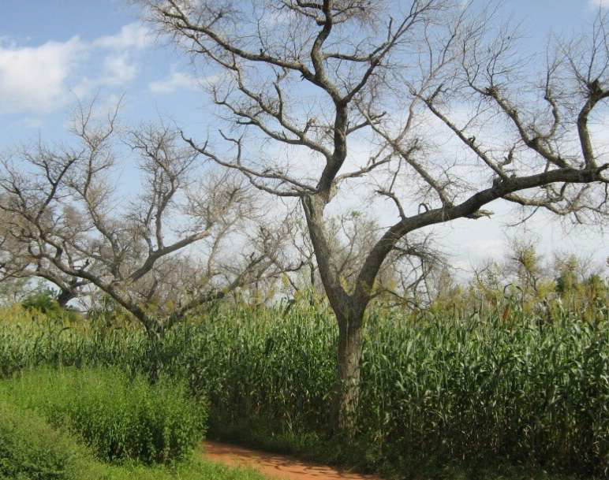

Slide 8
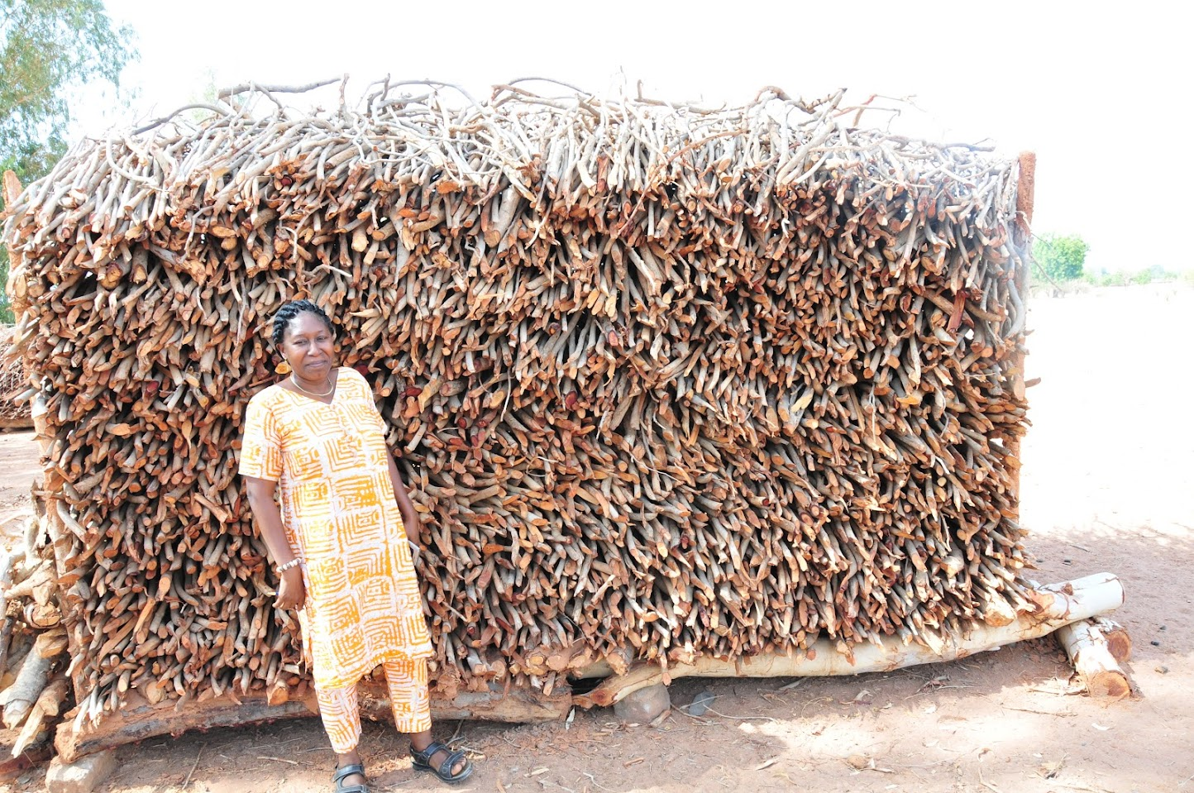
WHAT DO YOU NEED TO KNOW BEFORE IMPLEMENTING FMNR?
Understand the local context better:
How is land access norms exist?
What are the most sought-after wood species? For what uses?
Where are these species found? (In fallow land or crop fields, or grazing plots?)
What are the species regeneration techniques (planting, direct seeding or natural regeneration)?
Are there FMNR species that are prohibited?
For what reasons? What must be done to get these trees?

Slide 9
What outcomes do you want to achieve?
Which species are of interest to me?
Do these species grow naturally in my field?
If not, what actions can I take to produce them (planting or sowing)?
Is the desired area suitable for FMNR? If not, what are the constraints?
What concrete actions can be carried out to be successful?

Slide 10
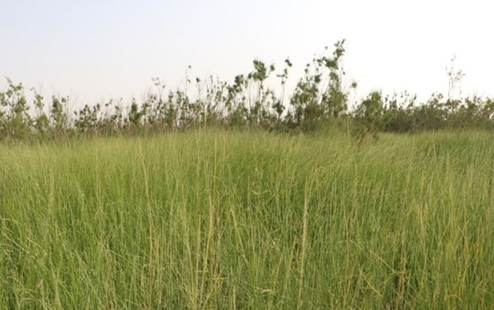
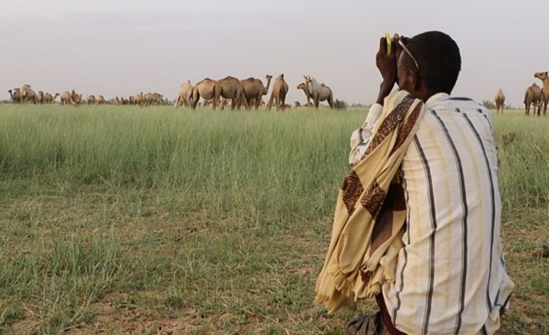
IMPLEMENTING FMNR
Six key steps:
Examine your field and identify the number of tree species
Identify the species to regenerate
Select 2 or 3 good stems and eliminate the rest
Trim the side branches on the lower half of the selected stems
Mark the selected stems with coloured cloth (identifiable from afar)
Community engagement: Work with the whole community to agree on rules that will protect selected trees in the field and respect everyone's rights. Raise awareness at all levels (men, women, community leaders, youth) on shared common benefits.

Slide 11
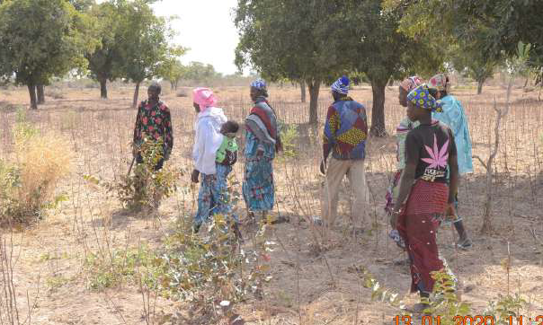
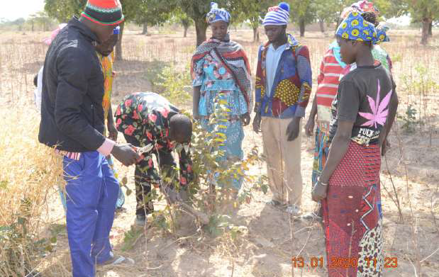
IMPLEMENTING FMNR
Step 1: Examine your field and identify the number of tree species
Select 50 - 100 stumps per hectare for regrowth during the dry season
Sep 2: Identify the species to regenerate

Slide 12
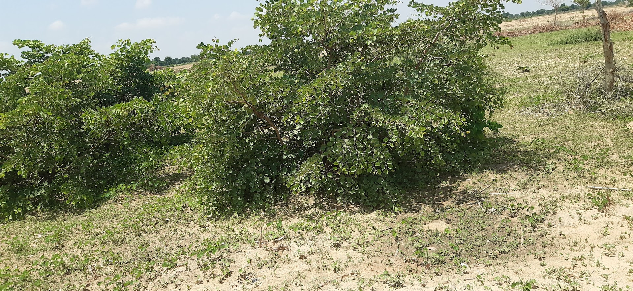
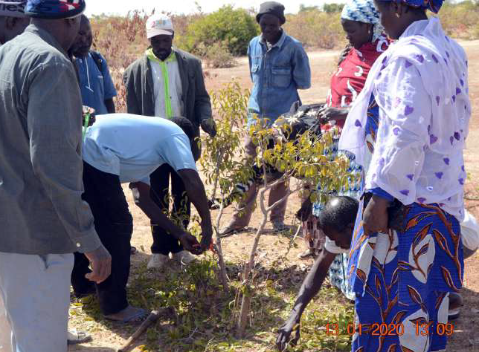
IMPLEMENTING FMNR
Step 3: Select 2 or 3 good stems a& eliminate the rest
Select the tallest and straightest stems and prune side branches to roughly half the height of the stem (using sharpened axe or machete and cutting upwards carefully).
Step 4: Trim the side branches on the lower half of the selected stems
Remove excess shoots, leave the cut leaves on the surface

Slide 13
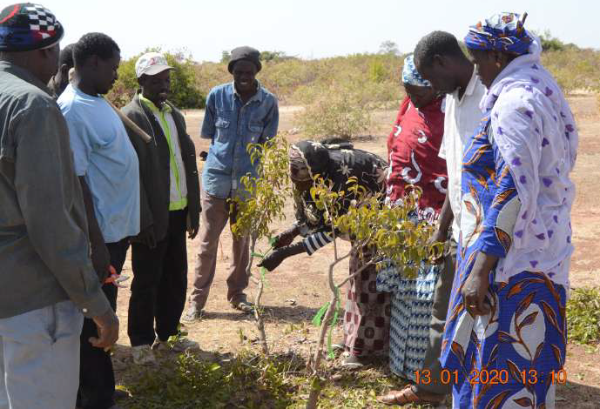
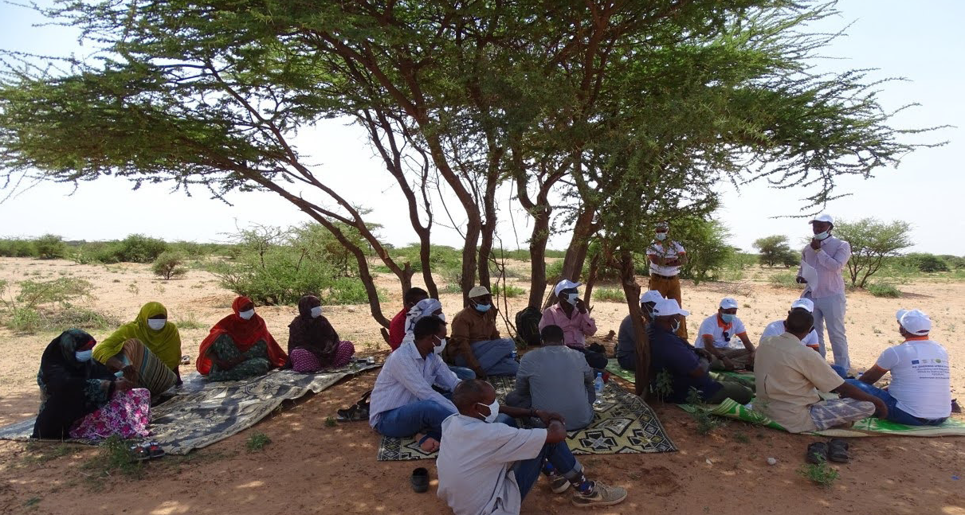
IMPLEMENTING FMNR
Step 5: Mark the selected stems with coloured cloth (identifiable from afar)
Prune any unwanted new stems and side branches (each 2-6 months).
Cut one stem (per tree) each year and let another grow in its place.
Step 6: Community engagement: Work with the whole community to agree on rules that will protect the selected trees in the field and respect everyone's rights. Raise awareness at all levels (men, women, community leaders, youth) on the common benefits and involvement of all

Slide 14
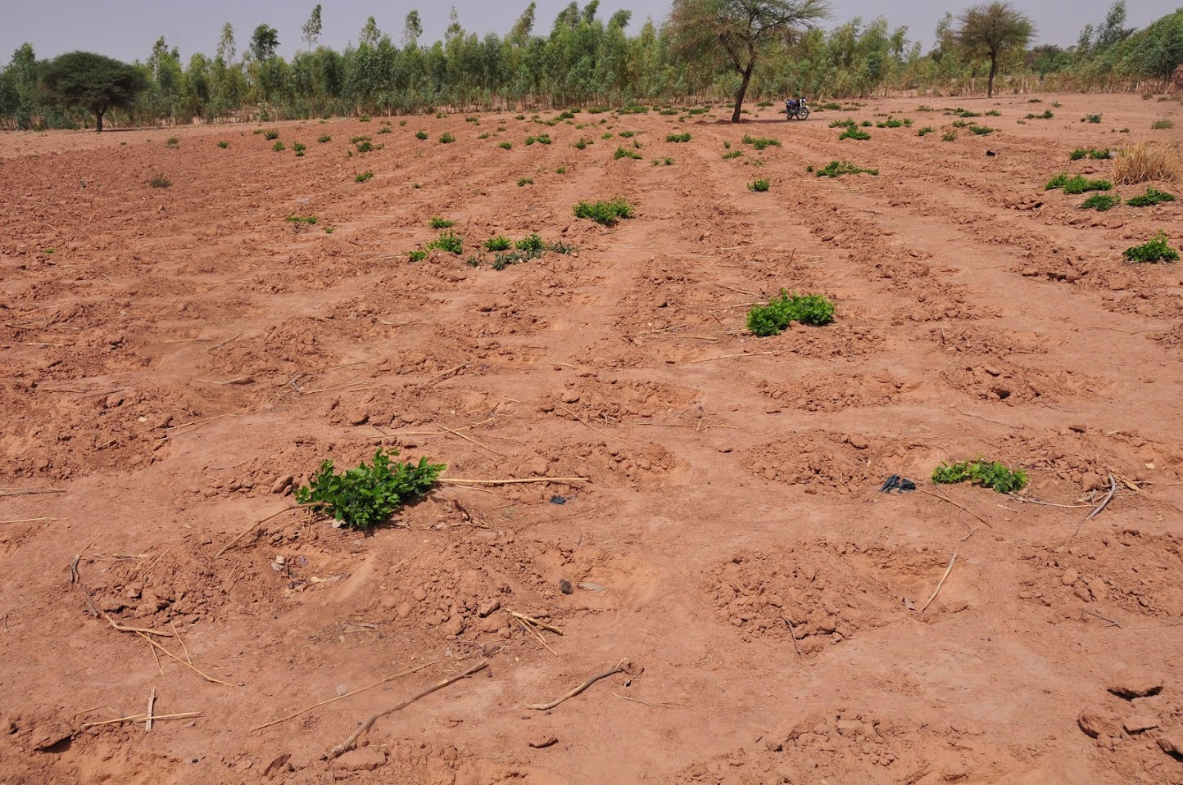
TECHNICAL STANDARDS
Flexible technical specifications : farmers or pastoralist manage their trees and fields as they choose – decide on species, no.of trees/density, and canopy.
Advisable to obtain a density that does not interfere with the crops. Density of 100 to 400 trees/ha depending on the species and their phenology and the choice of growers
For medium-sized species such as Balanites aegyptiaca, Faidherbia albida: 100 plants per hectare at 10m x 10m spacing;
For bushy species like Combretaceae: 400 per hectare at 5m x 5m spacing)
Basic competencies (selection, spacing, pruning, utilisation, etc)

Slide 15
TREES & CROP YIELDS
Improving water infiltration, providing the associated annual crops (cereals and legumes) with more water for longer periods of time;
Improving water conditions by bringing water to the surface and making it more accessible to crops;
Improving soil fertility through litter from foliar and root biomass;
Maintaining diversity by providing habitats for agricultural predators and pests;
Trees increase crop yields by: Protecting against wind and sun;
Mitigating temperature and climate by providing shade that in return increases crop production, especially in very hot environments, such as the Sahel;
Improving nutrition and food security for humans and livestock

Slide 16
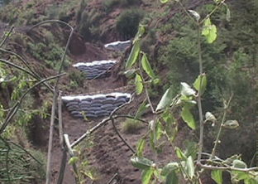
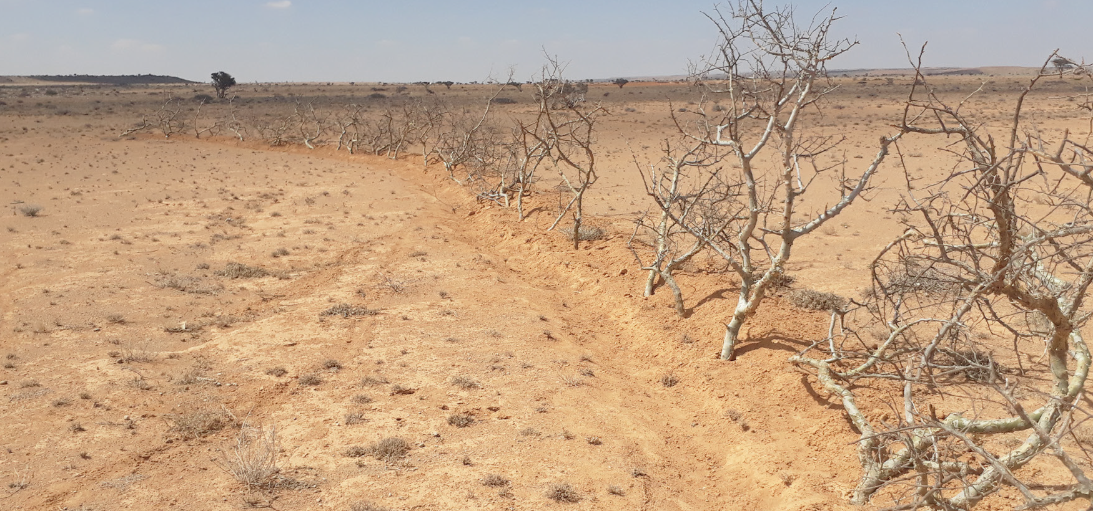
PRACTICES THAT PROMOTE FMNR
Take advantage of plots with existing soil and water conservation structures e.g. earth bunds, stone barriers, grass strips, terraces)- these encourage natural regeneration many forest species

Slide 17
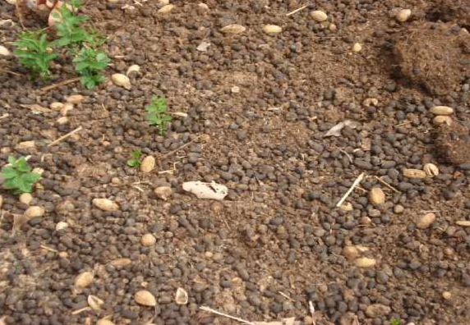
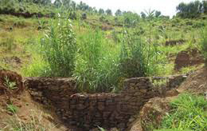
Manure application: Fruit seeds consumed by animals can be found in manure. These can then germinate in the fields when manure is spread in the field (e.g. Acacias, balanites). Desired seeds can also be added to promote biodiversity
Photo: BA Bationo

Slide 18
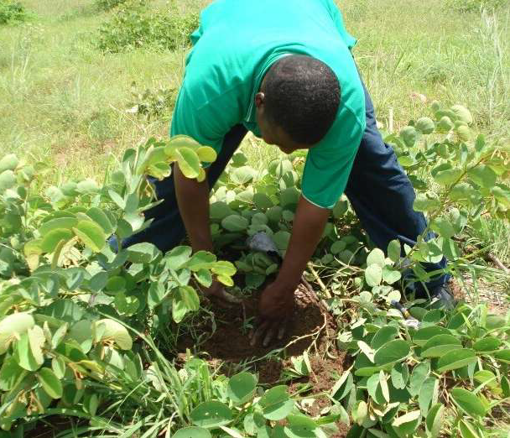
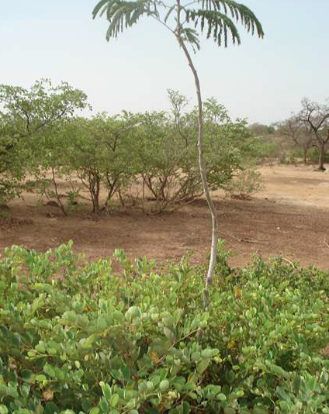
Certain shrubs or bushes play a facilitating role: e.g clumps of Piliostigma reticulatum (niama) are islands of fertility and 'refuge' for other species e.g. parkia
Photo: BA Bationo

Slide 19
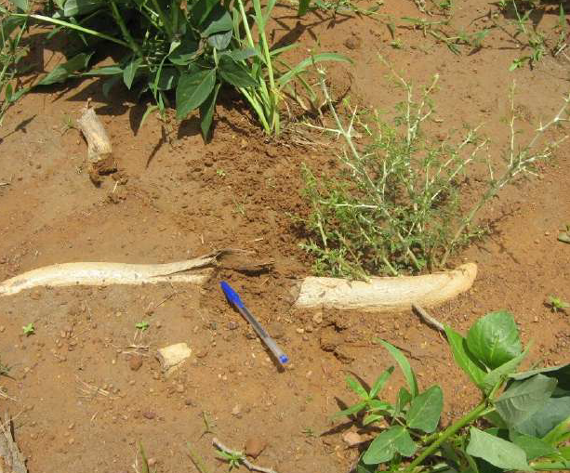
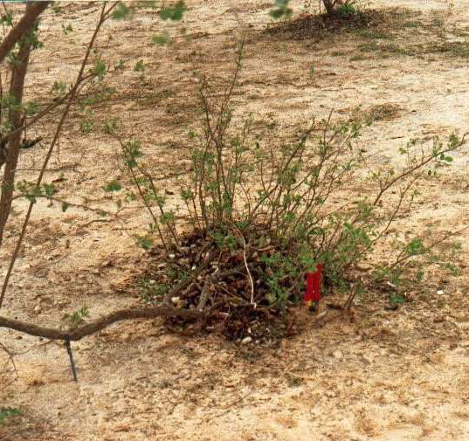
Capitalise on the ability of species to propagate vegetatively is key -can be achieved through layering, ground or suckering.
Photo: BA Bationo

Slide 20
Grass reseeding
Grass reseeding/improving ground cover - involves sowing grass seeds on the denuded lands at the beginning of the most reliable rain season.
In case of compacted soils, use hand hoes or ox-drawn ploughs are used to loosen or scarify the soil before reseeding.
Grass reseeding of FMNR site: RA CARE PUNTLAND
Notes:
This increases the success of reseeding with suitable fast-colonizing grass species. Grass reseeding is encouraged to hasten restoration of pasture, which can then be cut and fed to livestock off-site or sold to other livestock keepers. Reseeding can use native grass species or other high-value and fast-growing pasture varieties such as Africa fox tail grass

Slide 21
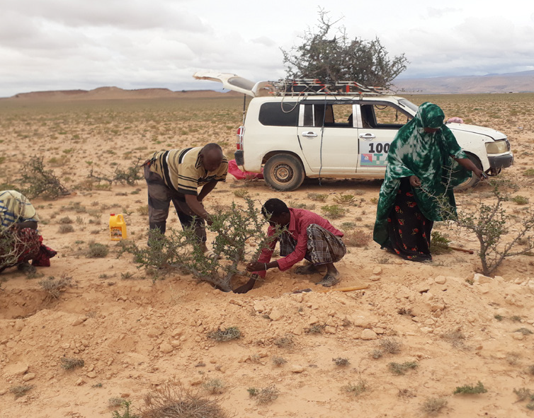
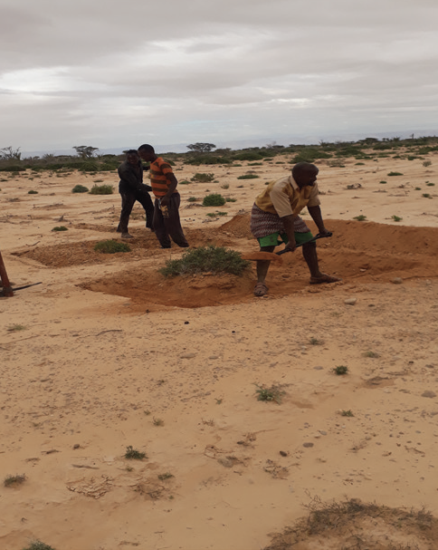
Enrichment planting requires procurement of good-quality planting materials. Produced in a tree nursery established by the community group or purchased from an existing nursery.
Enrichment planting of Commiphora trees from cuttings in an FMNR field in Puntland Photo: RA Somalia

Slide 22
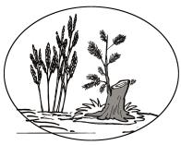
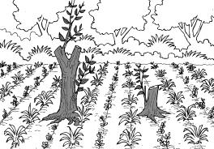
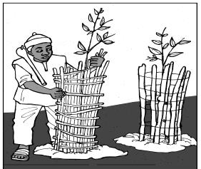
MANAGING TREES IN THE FIELD
The effectiveness of FMNR largely depends on tree management: pruning from the bottom to the top of the plant to reduce the crown when it becomes troublesome for production activities.
Pruning or maintenance cutting is also recommended from the lower branches. These techniques promote the rapid growth of FMNR trees and the exploitation of crop fields
Prunned branches - used as firewood, or as hedges for seeds sowed directly or young plants.
Use protection of young FMNR plants or planted trees.

Slide 23
Summary Tips
Cultivate farmer buy-in, key entry points : in-kind incentives, mindset change: dealing with related set backs e.g. birds, competition with crops, tillage practices)
Timing: consider: proper FMNR operations timing : one or two months before the rains
Farmer HH consultations bearing in mind farm spaces use e.g. for women, sons etc
Discuss ‘trees for what’/purpose and obtain consent to implement practice
Review tillage plans e.g. via oxen, tractor and how it might affect regeneration and tailor practices
Species options and selection after farm surveys/transects walks; identify options for enrichmen planting to fill gaps
Understand unique farm circmstances, situations and work with trees ‘fit’ for purpose, compatibility with other farm operations
Manage trees to increase productivity and farmer benefits e.g.. prunnings support biomass use (fertiity, firewood, fencing materials, mulching etc). Implies: implement prunning regime based on biomass needs and tree management goals
Promote use of the right tools for thininning, coppice and prunning operations to minimise tree stem damage and infestations
Involve farmers from the outset to mitigate mismanagement challenges such as bush encroahment in pasture areas
Manage wildlings in situ or translocate seedlings to safe areas while avoiding root damage e.g. in line planting design to allow tillage operations

Slide 24
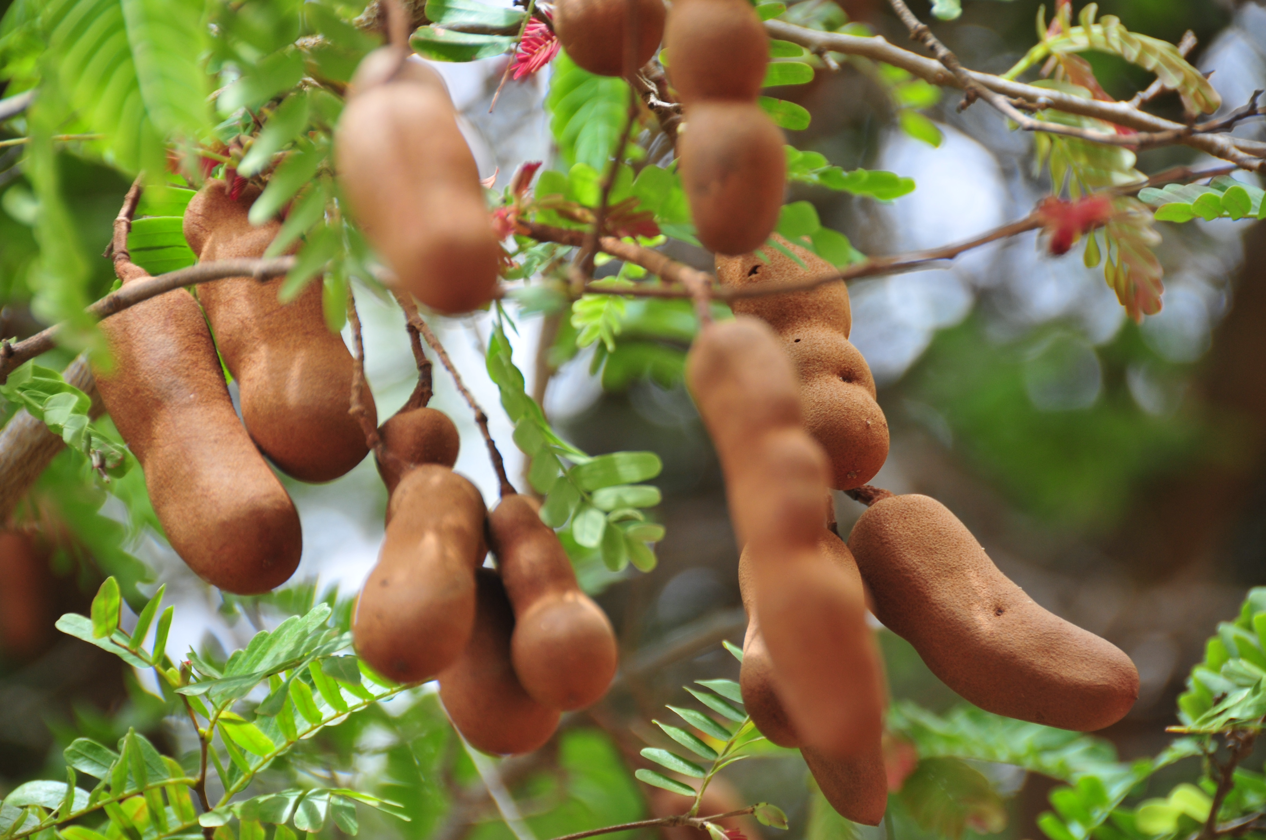


Discussions
Knowledge For The Great Green Wall Action (K4GGWA)

