Slide 1
Training of Trainers for OASIS
Group performance
Pamela Yoga - Yieke

Slide 2
Overview of Module on Group performance
Enhance team building, conflict management and self-management skills within EMGs to improve cooperation, effectiveness and the stability of environmental initiatives
Goal
Ensure EMGs develop self management capabilities and strategies to increase performance gradually

Slide 3

Stages of Team Development
Forming
Storming
Norming
Performing
Adjourning

Slide 4
Stages of team Development
These stages are commonly known as: Forming, Storming, Norming, Performing, and Adjourning.
Tuckman's model explains that as the team develops maturity and ability, relationships are established, and leadership style changes to more collaborative or shared leadership.
Tuckman's original work simply described the way he had observed groups evolve, whether they were conscious of it or not.
In the real world, teams are often forming and changing, and each time that happens, they can move to a different Tuckman Stage.
A group might be happily Norming or Performing, but a new member might force them back into Storming, or a team member may miss meetings causing the team to fall back into Storming.
Leaders should be ready for this and help the team get back to Performing as quickly as possible.

Slide 5
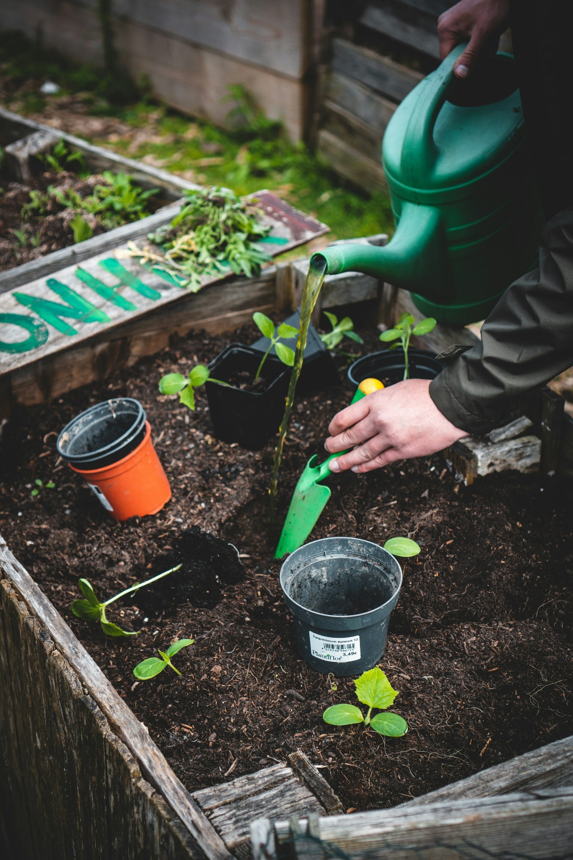
FORMING

Slide 6
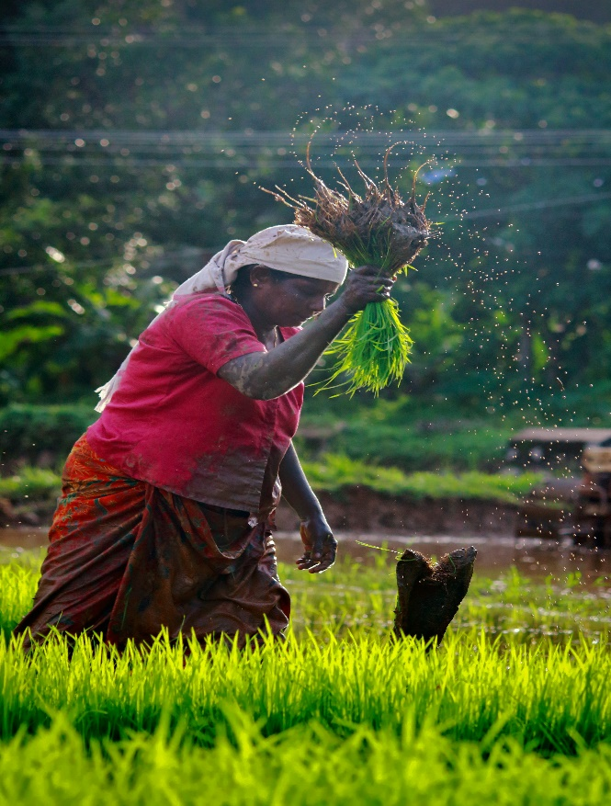
Forming
The stage of putting the structure of the team together.
Team members feel ambiguous, and conflict is avoided at all costs due to the need to be accepted into the group.
Team members look to a group leader for direction and guidance

Slide 7
Forming
Observable Behaviours
Politeness
Tentative joining
Orienting with others personally
Avoids controversy
Cliques may form
Need for safety and approval
Attempts to define tasks, processes, and decision making processes
Discussion of problems not relevant to the task
Feelings and Thoughts
Many feel excited, optimistic, and full of anticipation
Others may feel suspicious, fearful, and anxious working with others
Questions like ‘’What is expected of me’’
‘’Why am I here’’
Uncertainty and Apprehension

Slide 8
Forming
Leadership Required
Provide appropriate guidance & Instructions
Provide structure and task direction
Allow for get-acquainted time
Create an atmosphere of confidence and optimism
Active involvement
Team members believe an appointed leader necessary to make decisions
One-way communication from leader to team-members
Team Needs
Team mission and vision
Establish specific objectives and tasks
Identify roles and responsibilities of team members
Establish team ground rules
Team member expectations
Operational guidelines for team
Run meeting effectively
Schedule feedback from project leads/leaders

Slide 9
STORMING

Slide 10
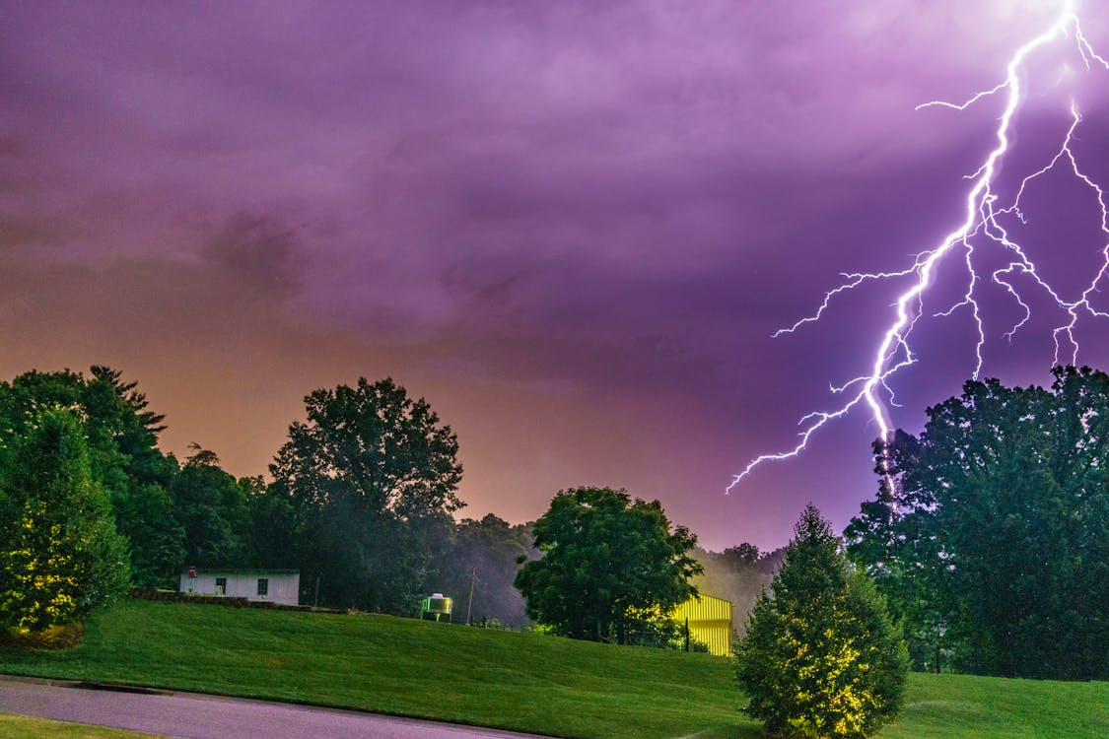
Storming
This stage begins to occur as the process of organizing tasks and processes surface interpersonal conflicts.
Leadership, power, and structural issues dominate this stage.

Slide 11
Storming
Feelings and Thoughts
Feel Defensive
Confusion, loss of interest can result
Resistance to tasks
Fluctuations in attitude about the team
Unsure if I agree with teams’ mission and purpose
Question the wisdom of team members
Increase in tension and jealousy
Unsure about my personal influence and freedom in the team
We're not getting anywhere
Observable Behaviours
Arguing among members
Vying for leadership
Differences in points of view and personal style are evident
Lack of role clarity
Team organizing itself
Power struggles and clashes
Lack of consensus-seeking behaviours
Lack of progress
Establishes unrealistic goals
Concern over excessive work

Slide 12
Storming
Team Needs
Inter & intrapersonal relationships
Identify stylistic and personal differences
Effective listening
Giving and receiving feedback
Conflict resolution
Clarify and understand the team’s purpose
Re-establish roles and ground rules
How to deal with ‘some’ team members violating team codes of conduct
Receiving Feedback from project guide
Leadership Required
Acknowledge conflict
Consensus among team members
Get members to assume more task responsibility
Concept of Shared Leadership emerges
Teach conflict resolution methods
Offer support and praise
Actively involved Team members begin consulting one another – shared leadership emerging but have difficulty with decision making

Slide 13
To progress…
to the next stage, group members must move from a "testing and proving" mentality to a problem-solving mentality.
The most important trait in helping teams move to the next stage is the ability of team members to listen to their teammates - what are they trying to say?

Slide 14
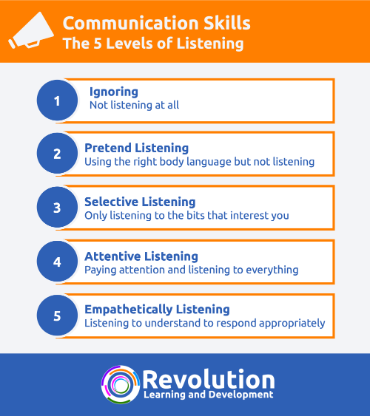
The 5 Levels of Listening

Slide 15
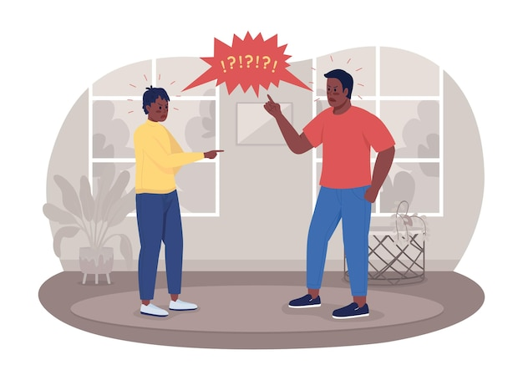
Definition of Conflict
Disagreements resulting from differences in opinion regarding:
  Resource distribution
  Information interpretation
  Methods
  Values
  Vision
Notes:
Differences over values and beliefs are more difficult to resolve as they involve one’s sense of identity and often fall under their “non-negotiable” (cultural values, religious, beliefs, etc.). At this level, it is difficult to separate the person from the issue—it becomes personal. Vision is even more difficult as it is a personal perspective of destiny, and quite rigid and difficult to reconcile.

Slide 16
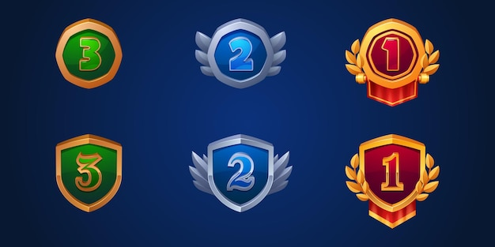
Levels of Conflict
Intrapersonal: internal to the person, it is about competing personal interests.
Interpersonal: involves competing interests between two or more people.
Group: involves competing interests among groups of people.

Slide 17
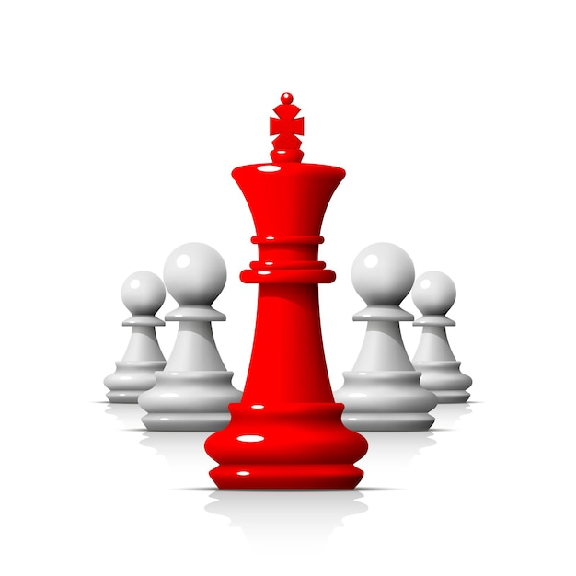
Conflict Management Strategies (Thomas Kilman)
Accommodating
Collaborating
Compromising
Avoiding
Competing
Notes:
Refer participants to page 107 in workbook.

Slide 18
Managing Conflict
COOPERATIVE
N O N
-
A S
S E R T I V E
ACCOMMODATING
Neglecting ones own needs to satisfy the other Party
Selfless generosity
Accepting instruction when one does not agree
Yielding to another’s point of view
COLLABORATING
Working with other party to find solutions which fully satisfy concerns of both parties
Exploring disagreements to learn from each other
Co-operatively resolving an issue
Confronting and finding a creative solution to an interpersonal problem
A SS E R T I V E
COMPROMISING
Finding an expedient solution mutually acceptable to both parties
  Exchanging concessions
  Bargaining
  50-50
AVOIDING
Not pursuing own concerns or those of the other party
Diplomatically side stepping an issue
Postponing an issue until a better time
Withdrawing from a threatening situation
COMPETING
Pursuing own concerns at expense of the other party
Standing up for rights
Defending a position which you believe is correct
Trying to win
NON / COOPERATIVE
Notes:
Model made famous by Thomas Kilman

Slide 19

NORMING

Slide 20
Norming
In this stage, team members are creating new ways of doing and being together.
As the group develops cohesion, leadership changes from ‘one’ teammate in charge to shared leadership.
Team members learn they must trust one another for shared leadership to be effective.

Slide 21
Norming
Observable Behaviours
Processes and procedures are agreed upon
Comfortable with relationships
Focus and energy on tasks
Effective conflict resolution skills
Sincere attempt to make consensual decisions
Balanced influence, shared problem solving
Develop team routines
Sets and achieves task milestones
Feelings and Thoughts
Sense of belonging to a team
Confidence is high
Team members feel a new ability to express criticism constructively
Acceptance of all members in the team
General sense of trust
Assured that everything is going to work out okay
Freedom to express and contribute

Slide 22
Norming
Team Needs
Develop a decision-making process
Be prepared to offer ideas and suggestions
Problem solving is shared
Utilizing all resources to support the team effort
Team members take responsibility in shared leadership skills
Receiving Feedback from project leads
Leadership Required
Shared leadership
Give feedback and support from Project leads
Allow for less structure
Promotes team interaction
Asks for contributions from all team members
Collaboration becomes clearer
Encouraging others in making decisions
Continues to build strong relationships

Slide 23
Task function and drawbacks at this stage
The major task function
is the data flow between group members: They share feelings and ideas, solicit, and give feedback to one another, and explore actions related to the task.
Creativity is high.
Collaboration emerges during this stage when team work ethic and shared leadership is understood.
The major drawback
is that members may begin to fear the inevitable future breakup of the team;
they may resist change of any sort.

Slide 24

PERFORMING

Slide 25
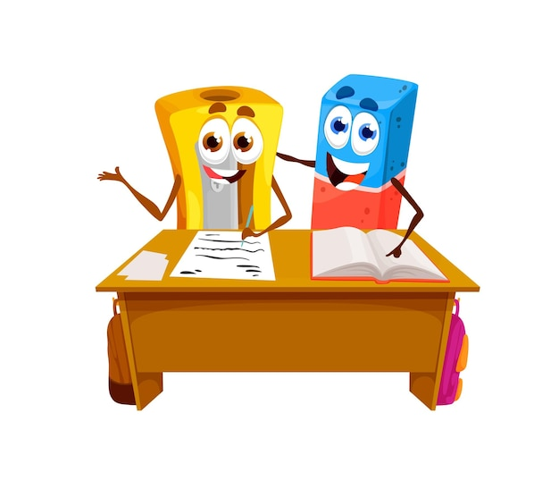
Performing
True interdependence is the norm of this stage of group development.
The team is flexible as individuals adapt to meet the needs of other team members.
This is a highly productive stage both personally and professionally.

Slide 26
Performing
Feelings and Thoughts
Empathy for one another
High commitment
Begin understanding collaborative work ethic
Tight bonds emerge
Fun and excitement
Lots of personal development and creativity
General sense of satisfaction
Continual discovery of how to sustain feelings of momentum and enthusiasm
Observable Behaviours
Fully functional teams
Roles are clearer
Team develops independence
Team able to organize itself
Flexible members function well individually, in subgroups or as a team
Better understand each other’s strengths and weaknesses and insights into group processes

Slide 27
Performing
Leadership Required
Shared Leadership being practiced
Observing, Inquiring, Fulfilling, team needs
Collaborative efforts among team members
Project leads provides little direction
Team members offer positive reinforcement and support
Share new information
Team Needs
Project leads assure team is moving in collaborative direction
Maintain team flexibility
Measure knowledge performance – post test
Provide information
Giving and Receiving Feedback and Dialogue with project leads

Slide 28
The Performing stage…
is not reached by all groups.
If group members can evolve to stage four, their capacity, range, and depth of personal relations expand to true interdependence.
In this stage, people can work independently, in subgroups, or as a total unit with equal competencies.

Slide 29

ADJOURNING

Slide 30
Adjourning
In this stage typically team members are ready to leave (project termination) causing significant change to the team structure, membership, or purpose
They experience change and transition.
While the group continues to perform productively, they also need time to manage their feelings of termination and transition.

Slide 31
Adjourning
Observable Behaviours
Visible signs of grief
Momentum slows down
Restless Behaviour
Bursts of extreme energy usually followed by lack of energy
Feelings and Thoughts
Sadness
Humour (that to outsiders could appear cruel)
Glad it is over – relief

Slide 32
Adjourning
Team Needs
Evaluate the efforts of the team
Tie up loose ends and tasks
Recognize and reward team efforts
Leadership Required
Project leads help team develop options for termination
Good listening
Reflection and carry forth collaborative learning to next opportunity

Slide 33
The final stage, adjourning…
involves the termination of task behaviours and disengagement from relationships.
A planned conclusion usually includes recognition for participation and achievement and an opportunity for members to say personal goodbyes.
Concluding a group can create some apprehension – in effect, a minor crisis.
The termination of the group is a regressive movement from giving up control to giving up inclusion in the group.

Slide 34
THANK YOU

